Slide 1




BOOKKEEPING EXPERT
At Bookkeeping Expert, we are dedicated to helping businesses in the UAE achieve financial clarity, compliance, and long-term growth. With over 13 years of experience, our team of certified accountants, tax consultants, and auditors provides tailored financial services designed to support businesses of all sizes and industries.
www.bookkeepingexpert.ae

Slide 2

WELCOME TO BOOKKEEPING EXPERT
Bookkeeping Expert is a trusted bookkeeping and accounting services firm based in Dubai, United Arab Emirates. With over a decade of experience helping businesses across various industries, Bookkeeping Expert delivers tailored financial solutions designed to support growth, compliance, and profitability in today’s dynamic market.
At the core of Bookkeeping Expert is a team of highly experienced accountants, tax consultants, and auditors who combine deep technical knowledge with practical business insight. They work closely with clients — from small startups to large corporations — to streamline financial operations, ensure regulatory compliance, and provide clear, actionable financial reporting.
www.bookkeepingexpert.ae

Slide 3



Our Services
Bookkeeping Services
Tax Consultancy
Accounting Services
VAT Return Services
Financial Reporting
Accounting Software Support
Auditing Services
Specialized QuickBooks Online
www.bookkeepingexpert.ae

Slide 4


Process Flows at
Bookkeeping Expert
Way to access information in Bookkeeping Expert
Offline Access
Online Access
We Follow the process suggested by the client or create the process for new systesms

Slide 5




Offline Access
Process For Offline Access
Gathering Data
Client uploads data to his secure serveror email them to us.
Access
Team access secure or email.
Distribution
Work is distributed by Team Leader to team member. Discuss and resolve issues if any..
Restore Data
Client can download and restore data from secure server
Upload
After review work, data uploaded to secure server &
inform to client
Review
Once work is completed by team member, work is
reviewed by team leader & management for quality assurance.

Slide 6


Online Access
Through Remote Desktop
Client uploads the document to his server and email them to us.
Work will be supervised by the team leads and management to ensure highest quality standards.
Our team connects to remotely access client’s computer via teamviewer, gotomypc,logmein etc.

Slide 7

Online Access
For Cloud based softwares
Client uploads data to his secure server or email them to us.
Team access secure and intimate back client on
data received.
Work is distributed to team by team leader.
Team access cloud softwares like QuickbooksOnline, Xero, Myob, Kashflow, Sassu etc.
Whole work is reviewed by team leader and management to give quality service.
Client will be intimated on the progress of work regularly.

Slide 8






Proud Membership

Slide 9












Softwares We Use

Slide 10




Softwares Certifications
Through our years of experience and hardwork, we are already certified by industry leaders like Intuit and Xero.
Quickbooks
Quickbooks Online
Xero
Certified ProAdvisor By - Intuit
Certified ProAdvisor By - Xero

Slide 11







Why Bookkeeping Expert ?
Secured infrastructures
Secured ftp for Data Transmission
24/7 power backups & 600mbps speed internet
All type of communication facilities are available
Antivirus installed and updated on all systems

Slide 12

Our Stats
500+
Clients have already been served
250000+
Hours of bookkeeping, Payroll processing with Tax return preparation services
13+
Years of Experience

Slide 13


Client’s Testimonials
“Nawal was great to work with and I will be seeking him out first for any future work.”
— CPA Jason Taylor, USA
“Bookkeeping Expert has been thorough and detailed in his bookkeeping, and immediately responsive in his communications via Skype or email. I’ve used Nawal’s services for over a year and plan to continue to do so!”
— John Pearce, United Kingdom
“NK did a full bottom-up review of our books for the year, made sure everything was recorded properly with extreme attention to detail. I was very impressed. Thank you NK.”
— Serge Jonnaert, USA

Slide 14
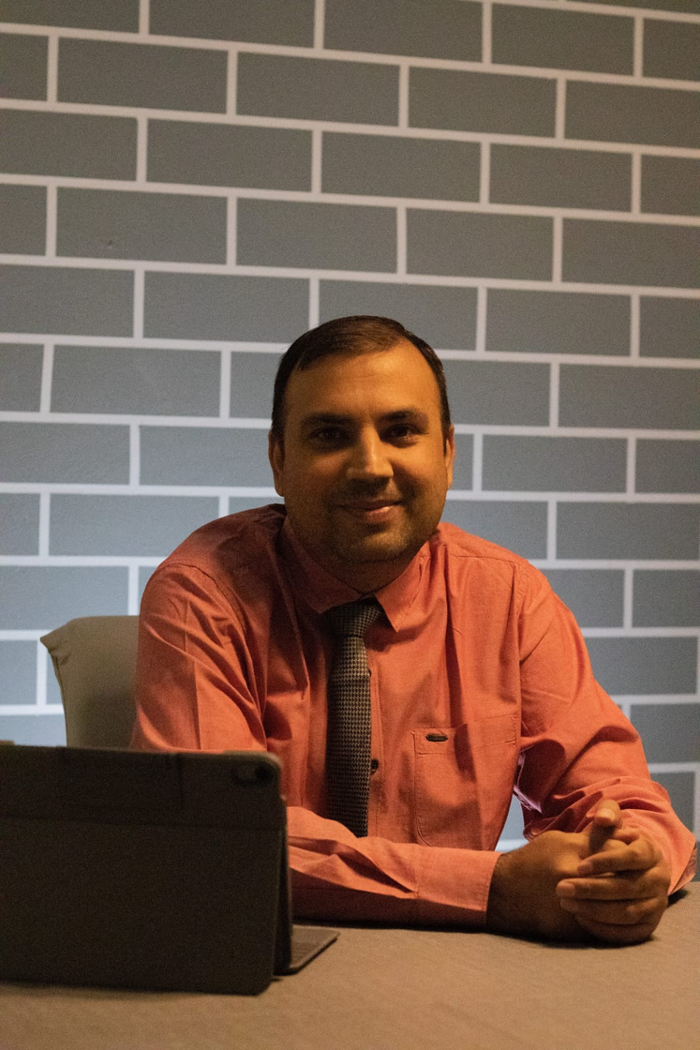
FOUNDER’S NOTE
“Bookkeeping Expert is not just a company—it is a vision built on passion, integrity, and a deep commitment to helping businesses succeed. From the very beginning, my goal has been to provide the highest quality financial and bookkeeping services that empower our clients with accurate, reliable, and meaningful financial information.
I firmly believe that every business, regardless of its size or industry, deserves the guidance of a dedicated financial professional—someone who can truly understand its numbers, evaluate its real value, and provide clear direction toward sustainable growth and long-term success.
At Bookkeeping Expert, we go beyond routine accounting. We strive to become a trusted partner in your journey, delivering transparency, compliance, and financial clarity so you can focus on what matters most—growing your business with confidence.
Thank you for trusting us to be part of your success story.
— Founder, Bookkeeping Expert”
Warm regards,
Nawal K. Tiwari
Founder & Director , Bookkeeping Expert
www.bookkeepingexpert.ae

Slide 15







Phone number: +971-42821071 , Mobile number: +971-503916508
info@bookkeepingexpert.ae
www.bookkeepingexpert.ae
Office-19, Reem Residence Building, Shop 1- Aaditya Business Center, Al Karama

Slide 16

THANK YOU
For Your Attention

